Slide 1
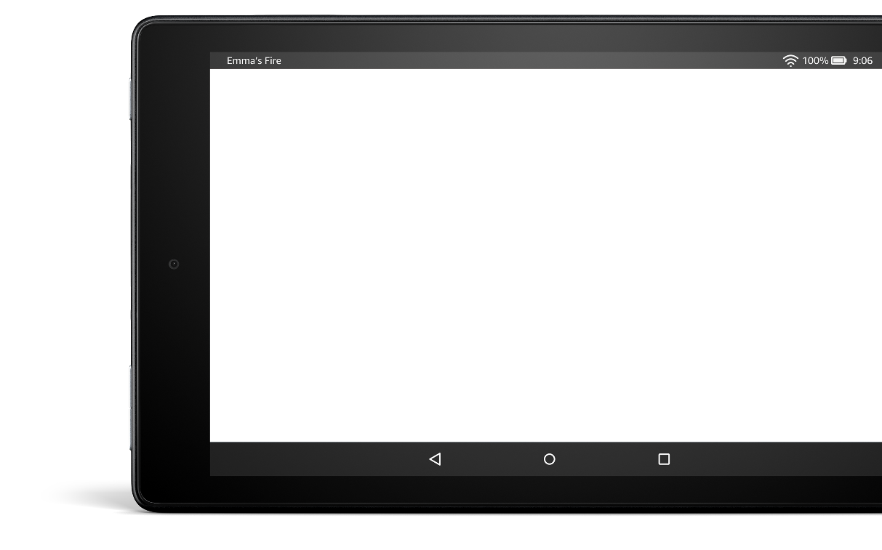
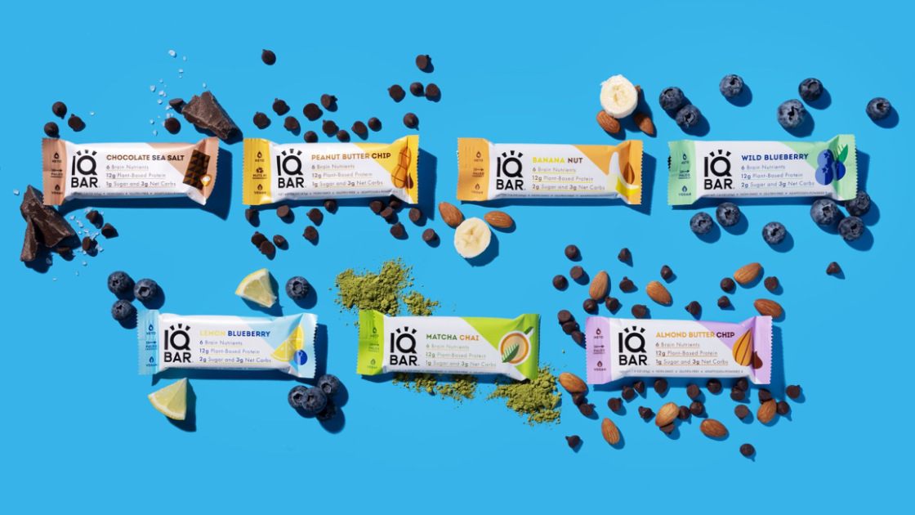
Experience | IQBAR
C A S E S T U D Y
Momentum Commerce
Full Service for IQBAR

Slide 2
Experience | IQBAR
Momentum Commerce Optimizes IQBAR ASIN Strategy in Tandem with Discount,
Drives 39% Increase in Units Sold (Q/Q)
The Challenge
IQBAR produces a variety of high protein bars and drink mixes for health-conscious consumers. Working with Momentum Commerce as the brand’s Amazon agency, one of their main focuses has been driving substantial growth on Amazon.
The Solution
Beginning on January 22nd, 2023, a multi-brand top deal went live across a top IQBAR ASIN.
To maximize the downstream impact of the increased sales, Momentum Commerce added the brand’s Sampler Pack, a product with many more reviews, to this listing.

Slide 3
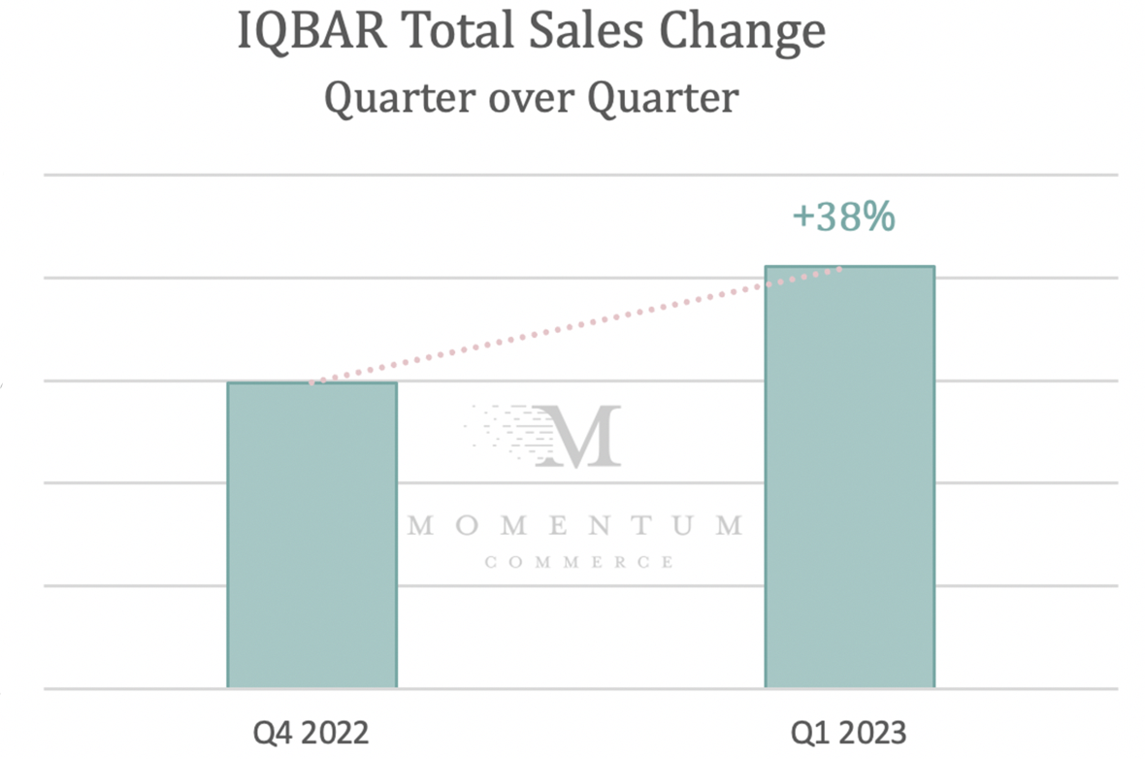
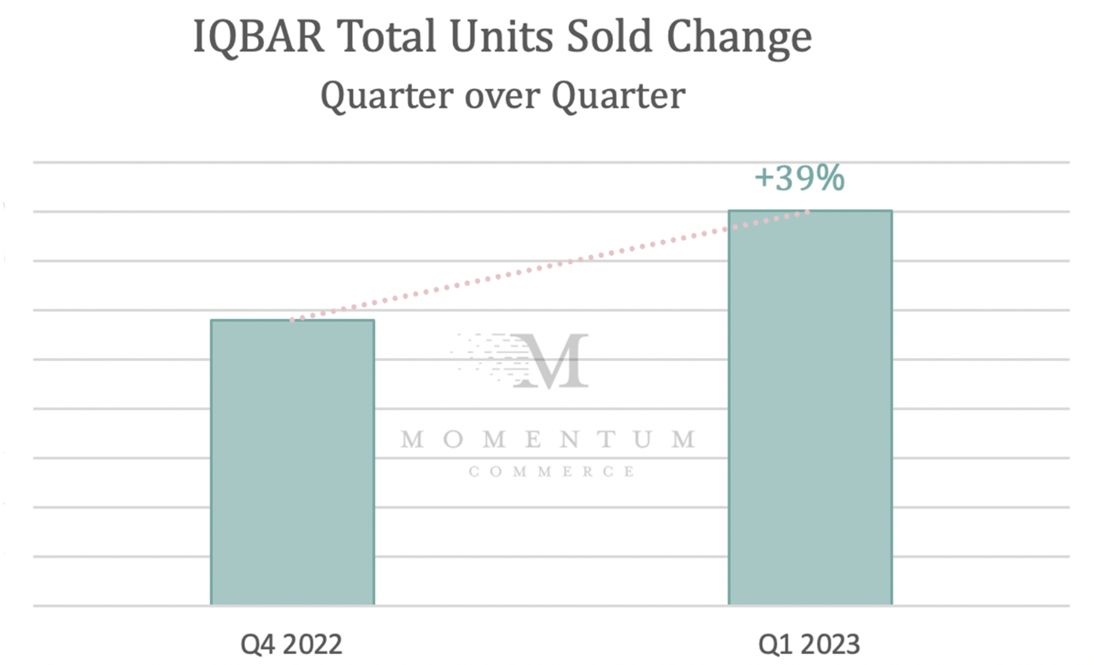
Experience | IQBAR
The Results
After incorporating the Sampler Pack and running the promotion, the listing earned a #1 Best Seller Badge for 11 days, accompanied by a substantial sales increase over time.
Compared to the prior three-month period, IQBAR saw:
38% increase in Total Sales
39% increase in Total Units Sold
97% increase in Glance Views for ‘High Protein’ Products
Momentum Commerce Optimizes IQBAR ASIN Strategy in Tandem with Discount,
Drives 39% Increase in Units Sold (Q/Q)

Slide 4
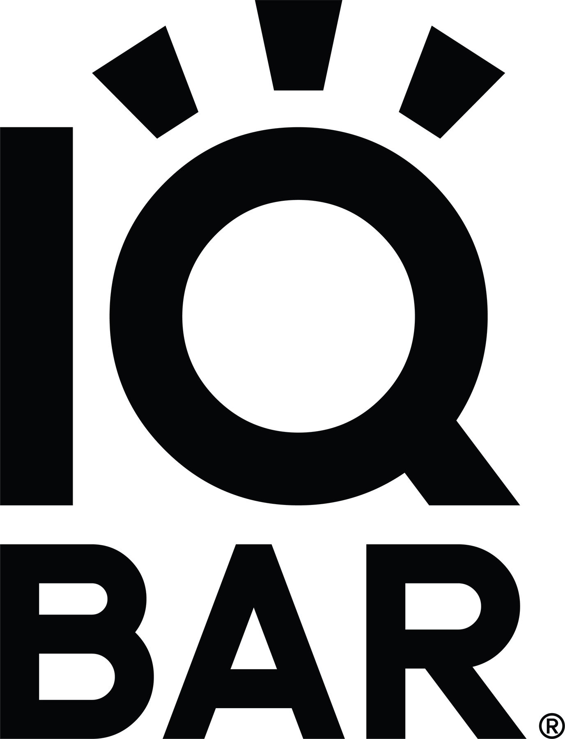
Experience | IQBAR
“
Momentum Commerce has helped us find and execute on operational changes that have meaningfully changed the trajectory of our Amazon business. Having that kind of partner in a incredibly competitive category is a major advantage.”
- Will Nitze,
CEO & Founder, IQBAR

